Slide 1
Renderer
Physics updater
cMesh list
Physical Prop

Slide 2
Renderer
Physics updater
cMesh list
Physical Prop

Slide 3
What we’re doing?
Part 1: What’s colliding with what?
Part 1a: Do something when that happens.
Part 2: Make it faster

Slide 4
Why Spheres?
Sphere collision detection is simple
You don’t have to worry about rotation

Slide 5
“Binding” – how are close are they?
Break encapsulation?
Do they “need to know” more then should
CRC

Slide 6
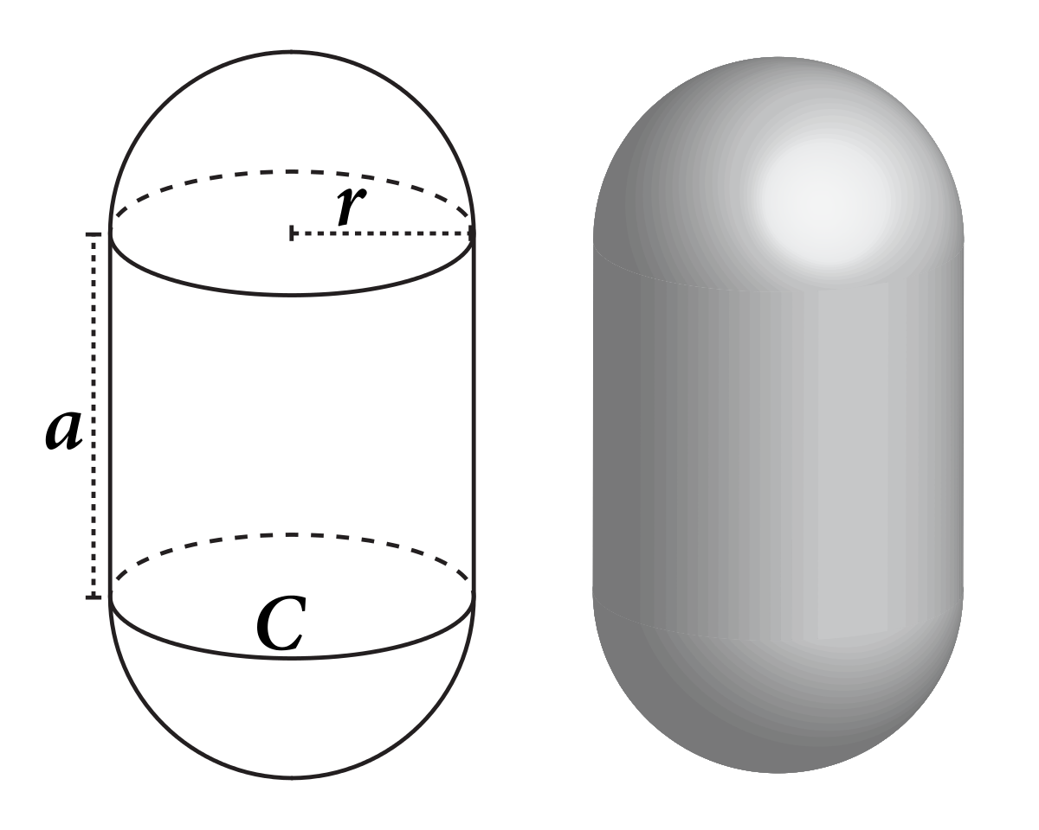

Slide 7
Steps in physics detection (and response)
Loop and update position, etc.
“integration” step
“Narrow phase”
Actual collision detection happens
“Broad phase”
Limit what gets compared to what

Slide 8
Narrow phase loop:
Do detection
Add something to indicate a collision
Do response after
i.e. lines 193 to 216 of cPhysics_IntersectionTests.cpp would be moved to another location
Add to some list, vector: sphere X hit triangle Y each time.
Then we go through that list for each object and see what the final result

Slide 9
The “collision event” list solves:
We can decide what to do what “this” particular collision (explode, stop, bounce…)
We can calculate multiple collisions from one object, like a sphere and multiple triangles.
We can also detect identical collisions:
Object 172 hitting Object 1627 is the same as Object 1627 hitting Object 172

Slide 10
Object 172 hitting Object 1627 is the same as Object 1627 hitting Object 172
A simple solution for this is to use their unique IDs (or pointer value) and only compare objects that GT or LT

Slide 11
A very simple, but effective solution is just stop the moving object.
This will mimic a large, heavy “soft” object that hits something but doesn’t bounce off.

Slide 12
Controlling the “motion” of objects.
Be careful about “just setting” the position of the object.
Move the objects very slightly per frame or not at all.
Or you want to “nudge” them:
Apply a “force” to them: which is really an acceleration on one (or a few) frames.

Slide 15
So what next (for you)?
Decide what types of collisions you want?
Sphere-Triangle or Capsule-Triangle gets you 99% there.
Or plane (sphere-plane)
Decide if and what kind of response you want
Easy: Stop the object if it hits something
Harder: calculate a response (based on the reflection)
Spheres colliding: the direction is based on the line between the centres. Calculate a plane that is perpendicular to that line and use the reflection normal from that plane.
Keep in mind the “response” can be spaceships exploding, etc.
That can be mimicked by spheres and triangles colliding

Slide 16
Normalize the line between the two centres.
Use GLSL reflect() to calculate the two reflection vectors along the velocity.
NOTE: You will need TWO “normals” because they are facing the opposite way.
The new velocity is the “speed” (length of the velocity vectors of each sphere) times this reflection ray.
If they spheres are different weights, then the resulting velocity is proportional to the weight ratios.

